Slide 1

The 2013 Conference of the North American Chapter of the Association for Computational Linguistics: Human Language Technologies

Slide 2
Overview
Schedule
Tutorials: June 09
Main Conference: June 10 – 12
Workshops: June 13 – 15
Student Research Workshop
Accepted Papers
89 long (acceptance rate: 30%)
51 short (acceptance rate: 37%)
13 student workshop
7 research papers (acceptance rate: 47%)
6 thesis proposals (acceptance rate: 75% )

Slide 3
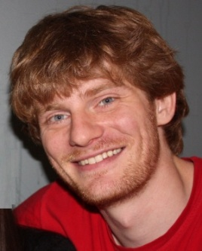
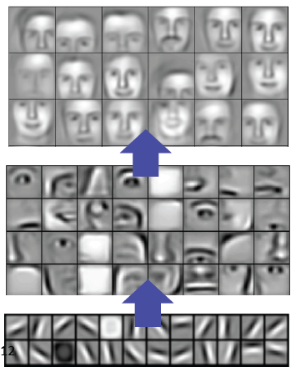
Tutorial
Deep Learning for NLP (without Magic)
Richard Socher and Christopher D. Manning
(Stanford University)
http://naacl2013.naacl.org/Documents/deep-learning-for-nlp-naacl-2013-tutorial.pdf
Take-home message
Learning multiple levels representations
Unsupervised pre-training is a key factor

Slide 4
Main Conference: Sessions

Slide 5
Interesting papers/talks
Invited talks
Gina Kuperberg (A hierarchical Bayesian approach)
Kathleen McKeown (from fact to fiction)
Best papers
The Life and Death of Discourse Entities: Identifying Singleton Mentions
Automatic Generation of English Respellings
Other interesting papers
Relation Extraction with Matrix Factorization and Universal Schemas
Learning a Part-of-Speech Tagger From Two Hours of Annotation
Named Entity Recognition with Bilingual Constraints
Multi-faceted Event Recognition with Bootstrapped Dictionaries
Generating Expressions that Refer to Visible Objects

Slide 6
Invited Talks 1/2
A hierarchical Bayesian Approach to Language Comprehension in the Brain
Gina Kuperberg
Department of Psychology, Tufts University
Department of Psychiatry, Massachusetts General Hospital
Take-home message
Forward + Backward Feedback
Deep learning?
Event
Prediction
Forward
Model
Concept
Word

Slide 7
Invited Talks 2/2
Natural Language Applications from Fact to Fiction
Kathleen McKeown
CS Department, Columbia University
Take-home message
How topic evolves in the last decades?
Fact -> Fiction (Genres)
News
Scientific Journal Articles
Online discussion
Personal narrative
Novels
Most annotated
Argumentative zoning
Citation sentiment
Prediction of Scientific Impact
Query-focused Summarization
Unedited
Dialog
Questions about Events
Reliability and influence
Coherent telling of a story
Compelling
Predicting when a narrative
is interesting
Comparative Literature
Constructing the
social network
Impact of Network Size

Slide 8
Best student paper
Automatic Generation of English Respellings
Bradley Hauer and Grzegorz Kondrak (Alberta, Canada)
Problem
Pronunciation [prəˌnʌnsi'eɪʃn] is not perfect
E.g., “Huatulco” (Mexican resort) → “wah-tool-koh”
Take-home message
Map English spellings to pronunciations (MT)
“Identify a new problem, build a model that is hard to beat”
Usage: Foreign Name?
Wencan Luo (when-sun-law)

Slide 9
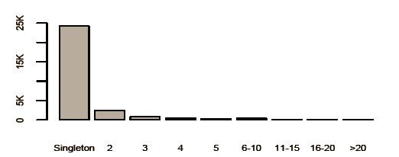
Best short paper
The Life and Death of Discourse Entities: Identifying Singleton Mentions
Marta Recasens, Marie-Catherine de Marneffe, Christopher Potts (Stanford University)
Predict Lifespan Model
Singleton: Entities that appear only once
Coreferent: more than once
Take-home message
Lifespan model improves state-of-the-art coreference resolution
Stanford Coreference resolution system

Slide 10
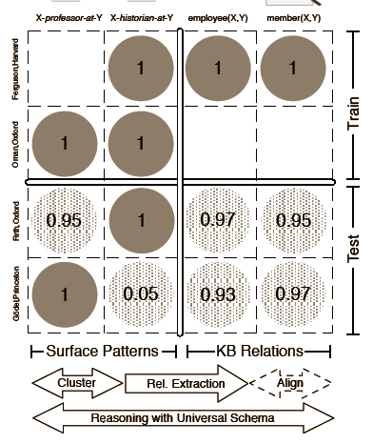
Papers (1/5)
Relation Extraction with Matrix Factorization and Universal Schemas
Sebastian Riedel (College London, UK)
Limin Yao, etc. (Massachusetts at Amherst)
Take-home message
Universal schema:
surface form & relations
“Oman is a professor at Orchard”
Inference -> Learn latent vectors
Matrix computation

Slide 11
Papers (2/5)
Learning a Part-of-Speech Tagger From Two Hours of Annotation
Dan Garrette, Jason Baldridge (Texas at Austin)
Take-home message
Close to state-of-art but low cost
Supervised + unsupervised model
Tag dictionary expansion, Graph Model, etc.

Slide 12
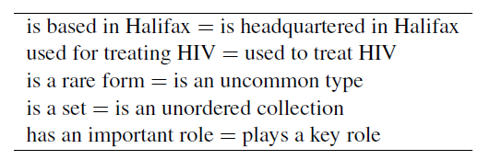
Papers (3/5)
Minimally Supervised Method for Multilingual Paraphrase Extraction from Definition Sentences on the Web
Yulan Yan, etc. (NICT, Japan)
Universal Communication Research Institute
Paraphrase
Take-home message
Make good use of public corpus
Definition Extraction
“A paraphrase is a restatement of the meaning of a text or passage using other words.” (first sentence in wikipedia)
Overlap between multiple definitions

Slide 13
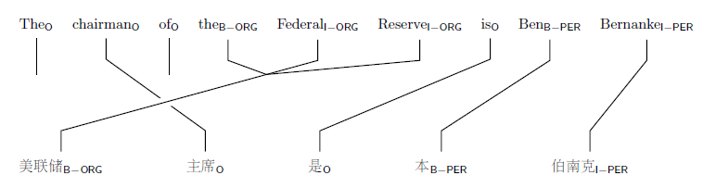
Papers (4/5)
Named Entity Recognition with Bilingual Constraints
Wanxiang Che (Harbin Institute of Technology, China)
Christopher D. Manning, etc. (Stanford)
Take-home message
Bilingual sentences contain complementary cues.
ILP is used in the inference phrase to put some constraint
Use the bilingual sentence as the constraint
A is NE in L1, A is NE in L2, too.

Slide 14
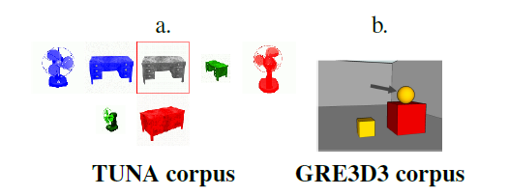

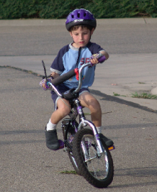
Papers (5/5)
Generating Expressions that Refer to Visible Objects
Margaret Mitchell (Johns Hopkins)
Kees van Deemter, Ehud Reiter (Aberdeen, UK)
Take-home message
Toy example but foresight
“A boy is riding a bike”

Slide 15
People I met
Fei Liu, Bosch, (graduated from Texas at Dallas)
My mentor in SWR
How to publish good papers?
“All graduates are encouraged to publish their bullshit”
Kristy Boyer (AP at NC State University)
Researchers' schedule
Liu Yang (Prof @ Texas at Dallas)
Lei Chen (ETS)
Automatic scoring for TOEFL Spoken Test

Slide 16
Some lessons
Well prepared
A good notebook
iPad is not good
long battery life
More clothes

